Slide 1
Analysis of vehicle suspension system using matlab and simulink
Presented by:
Sayan Das 234103110
P Venumadhav 234103428
Aamir Haider 234103402

Slide 2
INTRODUCTION
The purpose of the suspension system in automobiles is to improve ride comfort and road handling.
The suspension system modeled considered here is a two degree of freedom quarter car model.
In the project we study the nature of the system’s response, due to different inputs and initial conditions, by checking the output of the “scope blocks” in their model.
Time domain simulations are carried out to test the performance of the suspension system under different types of road profiles which are the primary inputs of the system.

Slide 3
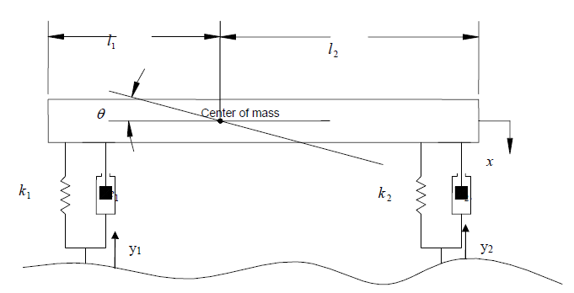
MATHEMATICAL MODEL
Using Lagrange’s equations to derive the governing
differential equations of motions, describing the
bounce and pitch motions.
Using MATLAB, obtain the natural frequencies of
the system and the corresponding mode shapes.
Verify the results in part b by using the Lagrange’s
equations.
With the help of MATLAB obtain the Transfer Function for both the bounce and pitch motions.
Using SIMULINK, obtain the system response to the road excitation.

Slide 4
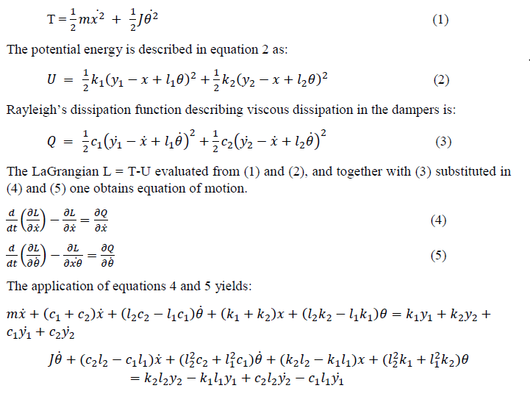
EQUATION OF MOTION

Slide 5
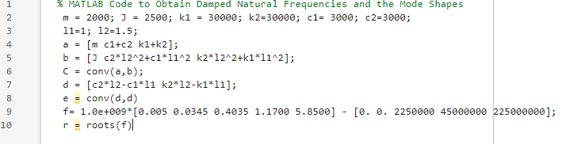
MATLAB CODE :

Slide 6
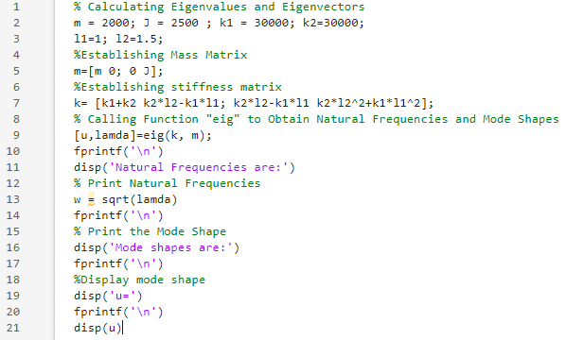
MATLAB CODE (Continued):

Slide 7
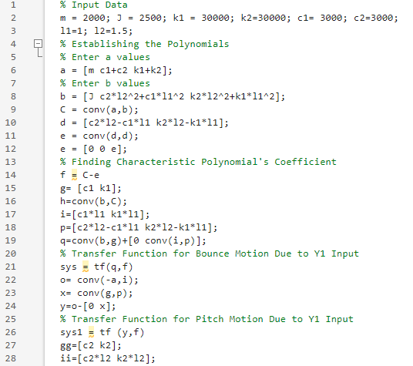
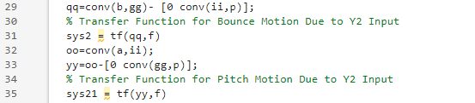
MATLAB CODE for transfer function (Continued):

Slide 8
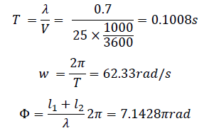
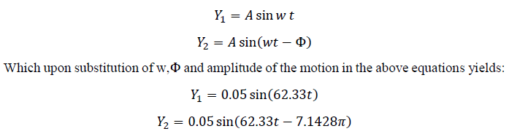
PROBLEM SIMULATION
We will now simulate the motion of the car on the road. We have assumed that the road is
approximated as sinusoidal in cross section with amplitude of 50 mm and the wavelength
λ = 0.7m. The car is traveling at 25 km/hr. these conditions provide the inputs Y1 and Y2
for the simulation. The period and cycle frequency for the harmonic inputs and the phase
delay due to input Y2 are as follows:

Slide 9
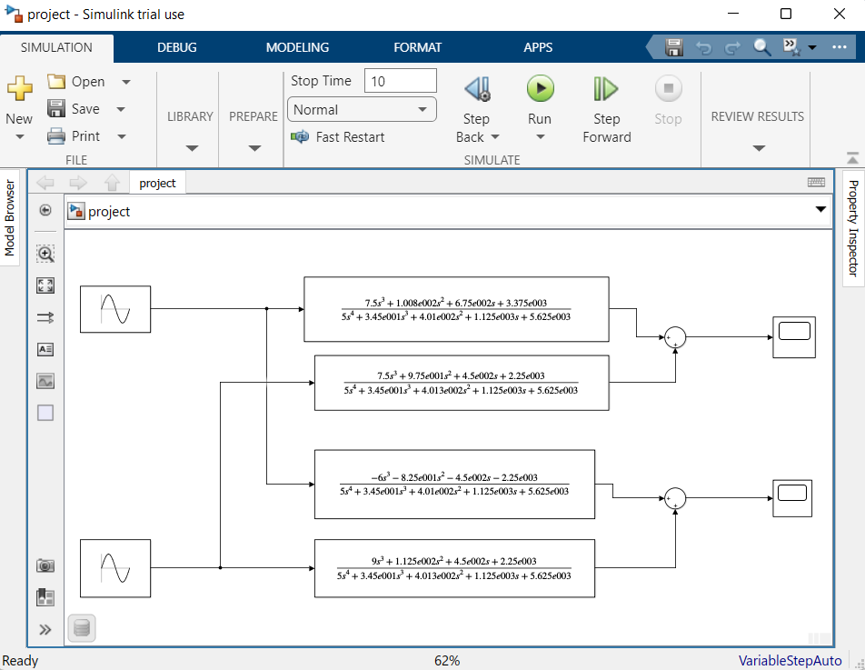
SIMULINK MODEL:

Slide 10
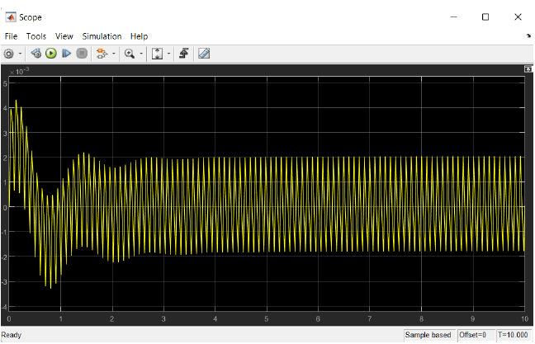
RESULTS :
The speed breaker is to excite the vehicle’s suspension system. The first profile input is assumed a single bump with
50mm height and second bump of amplitude of 50mm, and wave length of two bumps of 0.7m.
These are the inputs to the SIMULINK model.
The Transfer Functions which were derived in the above MATLAB code is also seen for each input and system response.

Slide 11
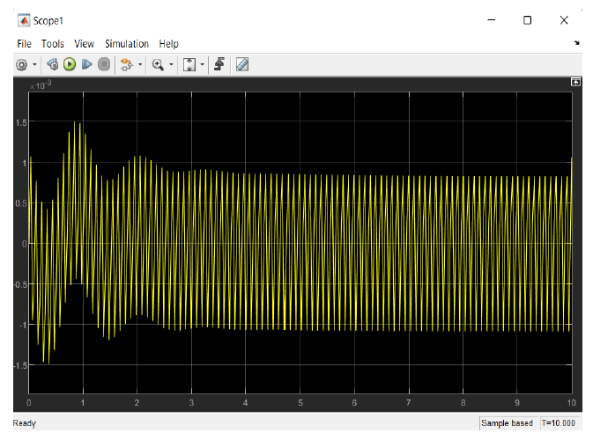
RESULTS (Continued) :
“Scope 1” indicate the transient contribution to the response with the steady amplitude for the pitch motion being
about 1.0 × 10−3rad. The current pitch values for the system reduces the vibrations transmitted to the suspension
body.

Slide 12
CONCLUSION
The results obtained from running the MATLAB code; The mode shapes indicate that there is no phasing in the modes as expected in the proportional damping case and decaying nature of oscillation.
The complex roots obtained in MATLAB code indicate the first and second damped natural frequencies and real part of the complex roots indicates the decaying nature of the oscillation.
Natural frequencies are 𝑤𝑛1 = 5.1403 rad/s and 𝑤𝑛2= 6.5252 rad/s.
Mode Shape values are u1 = -2.0957 and u2 = 0.5965.
Bounce response of the system = 20mm.
Pitch response of the system = 1.0 × 10−3rad.

Slide 13
THANK YOU

